Slide 1
iSHELL
INSTRUMENT CONTROLLER
OVERVIEW
Tony Denault – Software Programmer
Eric Warmiber – Electronic Engineer

Slide 2
What is the iSHELL Instrument Controller?
iSHELL has 3 control systems.
Spectrograph Camera System – Computer, Controller, and electronics used to readout the H2RG Array.
Guider Camera System – Computer, Controller, and electronic used to readout the Aladdin Array.
Instrument Controller System – Computer, controllers, and electronics to do:
  Motor control
  Temperature control and monitoring
  A/C power control.
  Other hardware control.

Slide 3
What is controlled by the iSHELL Instrument Controller?
On page 4 of the Instrument Controller Overview, a table lists the items to be controller. Below is summary of these items.
12 Mechanisms using stepper motors. 3 are warm located in the calbox, and 9 are cold located inside the dewar.
Sensing for ~23 position sensors or switches. A combination of analog and digital channels.
5 Temperature Control loop: H2RG, Aladdin, Grating #1, Grating #2, and the Gas Cell.
10 Channels of temperature monitoring.
Power control for 3 calibration lamps.

Slide 4
The iSHELL Instrument Controller
Our plan for the iSHELL Instrument Controller is to copy of the SpeX Instrument Controller.
SpeX is currently being upgraded. Its instrument controller is being replaced. SpeX has:
6 stepper motor (warm).
2 servo motors (warm)
4 A/C power outlets (Lamps)
2 temperature controllers (H2RG, Aladdin).
10 channels of temperature monitoring.
8 channels of analog input.
The SpeX Instrument controller is being built and written so that it can be replicated for iSHELL.
This provides iSHELL with a proven design that can be implemented very quickly.

Slide 5
The iSHELL Control System Block Diagram
iSHELL Control System diagram on page 6.
Color coding:
Orange = iSHELL
Purple = H2RG and Aladdin Camera Systems
Blue = Instrument Controller
Instrument Controller PC in the computer room.
Hardware controllers are located in the coolrack electronic box at the telescope.
All cool rack controllers are access using Ethernet.
All hardware has be used at the IRTF or is being used in the SpeX upgrade.

Slide 6
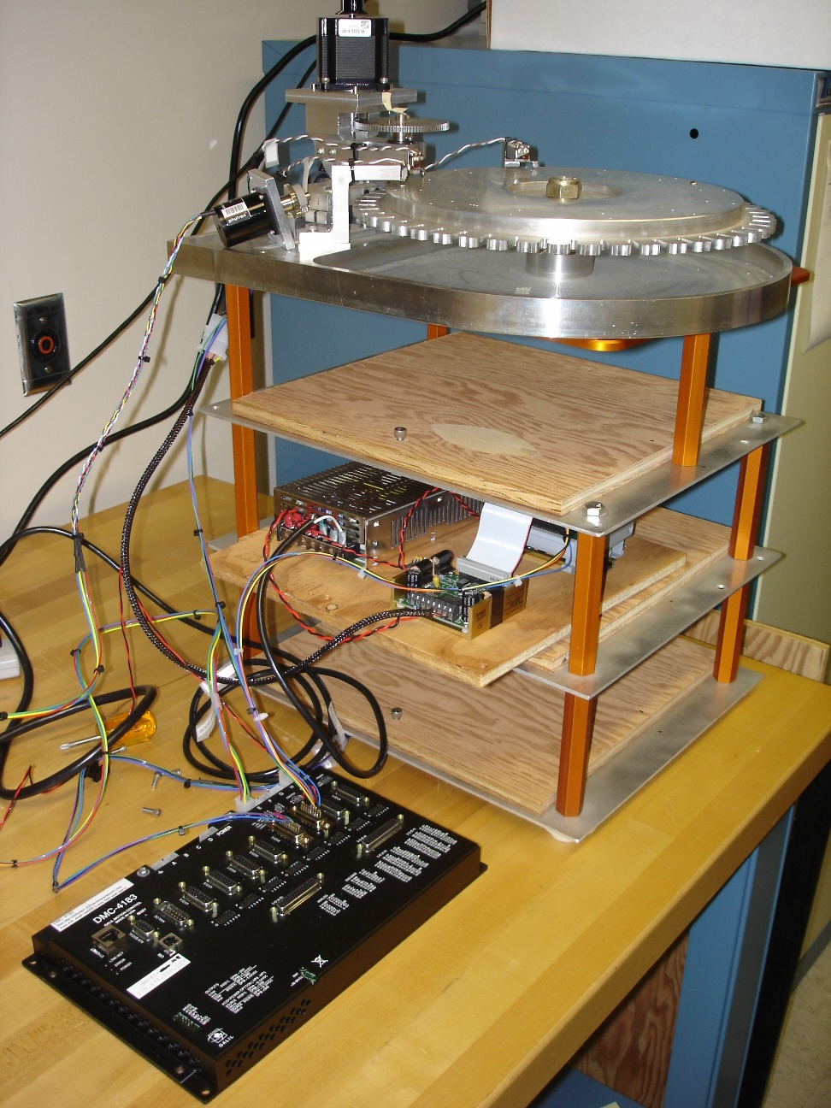
iSHELL Instrument Controller Hardware 1
IMS stepper motor
Galil DMC-4183 Motor Controller
8 axis motor controller
8 analog inputs
16 digital input
16 digital outputs
Ethernet interface.
IM483-24PI micro stepping motor driver.
Warm phytron motor
IM483 driver
DMC 4183

Slide 7
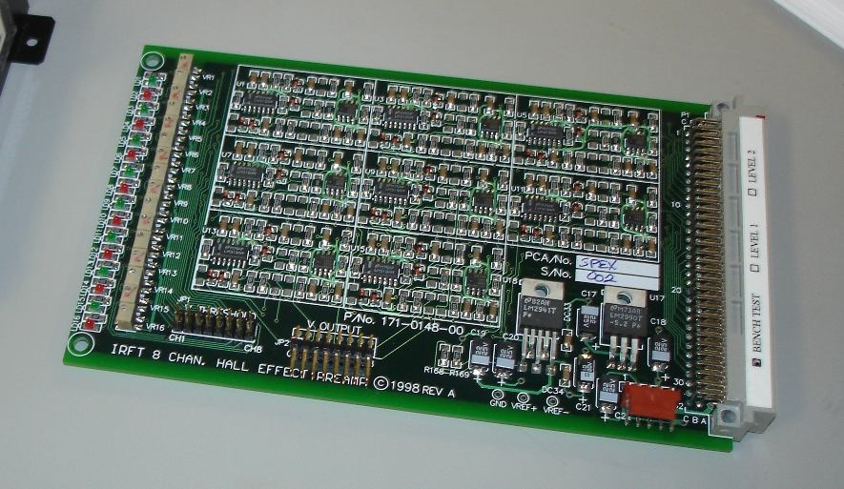
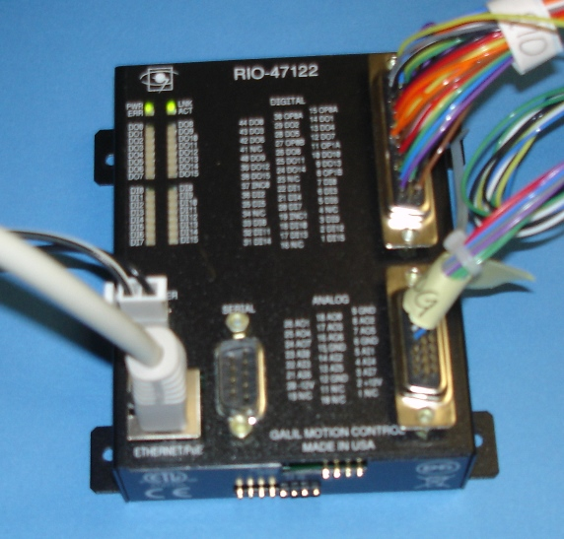
iSHELL Instrument Controller Hardware 2
Hall Effect Sensor Conditioning Hardware
The current SpeX comparator board is shown. In-house design.
We plan to use an updated version of the this board for the SpeX upgrade, and iSHELL.
For Additional Analog or Digital IO
Galil RIO-47120-16bits
8 analog inputs
8 analog outputs
16 digital inputs
16 digital outputs
Ethernet port
Used by the IRTF TCS.

Slide 8
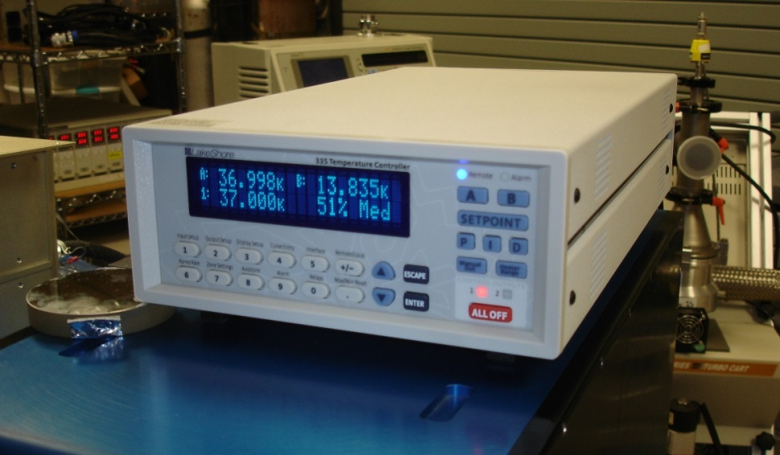
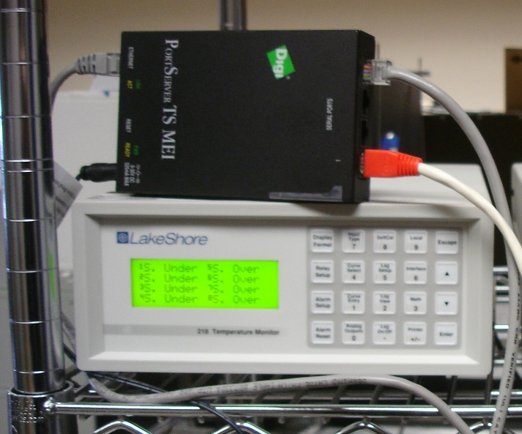
iSHELL Instrument Controller Hardware 3
Lake Shore
335 Temperature Controller
Newer version of the 330 (SpeX), 332 (NSFCAM) used by the IRTF.
Ethernet interface provide by a Prologix GPIB-Ethernet device.
Lake Shore218 Temperature monitor
Newer version of the 208 used by SpeX.
Interface is RS-232
Digi PortServer
RS-232 to Ethernet
IRTF uses various model of the PortServer..

Slide 9
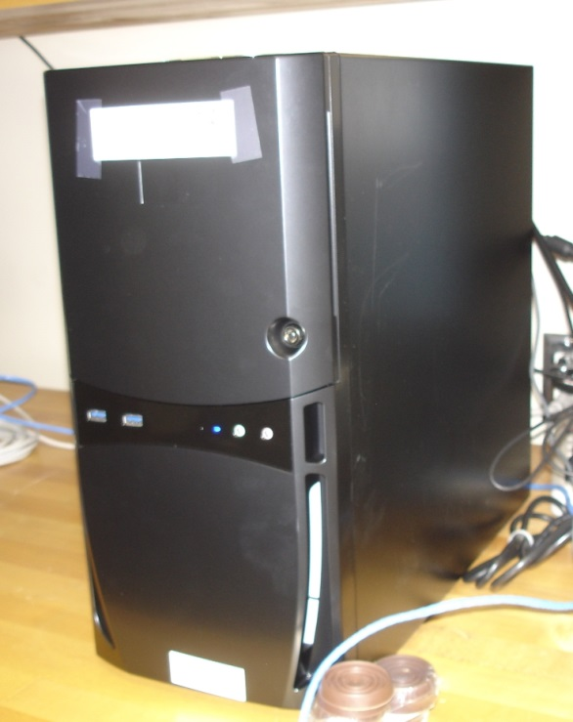
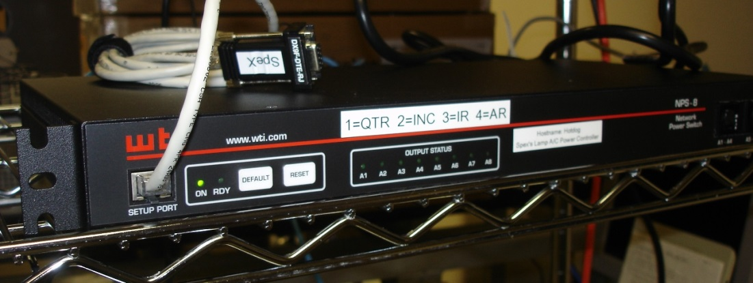
iSHELL Instrument Controller Hardware 4
Instrument Controller Computers
Standard PC
Linux OS
Being used to develop the SpeX Instrument Controller Software.
WTI NPS-8
8 outlets of A/C power control over Ethernet.
To be used for Calibration Lamps.

